Slide 1
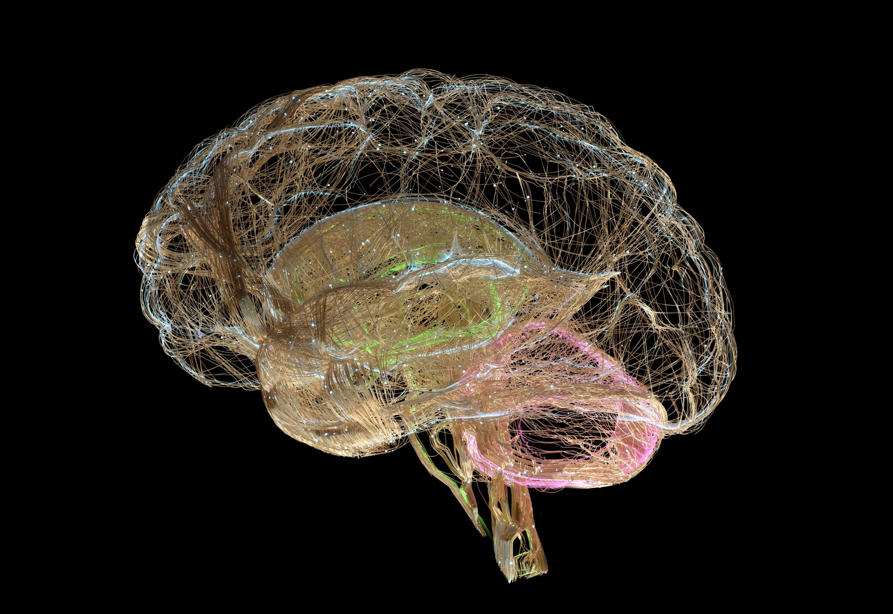

Stroke Predictions Using Machine Learning
By: Monica Santana
Notes:
The models presented will predict stroke or non-stroke diagnosis in the patients. There were also be visualizations to help see what factors may contribute to getting a stroke and early detection will allow for earlier lifestyle changes that can help prevent a stroke in the future. Now let’s go over stroke statistics and how it has impacted the U.S.

Slide 2

Stroke Statistics in the US
2 types of strokes
Hemorrhagic
Ischemic
According to the CDC, “every 40 seconds, someone in the United States has a stroke.”
Many risk factors for all ages include high blood pressure, high cholesterol, diabetes, smoking, and obesity
Notes:
If caused by a clot obstructing the flow of blood to the brain, it’s an ischemic stroke but if it is caused by a blood vessel rupturing and preventing blood flow to the brain, it is called a hemorrhagic stroke. Both types have the same risk factors and can happen at any age. The dataset I will be using does not specify which form of stroke the patient got, but for this analysis it does not matter since the risk factors are the same.

Slide 3
The Dataset
This dataset will be using demographics and medical records of patients to make predictions whether certain factors may have caused them to have had a stroke or not
The dataset is from Kaggle, and it has 5110 rows and 12 columns
I will only use the medical related features and not include the features of ID, ever married, work type, or residence type
Notes:
I want to keep the analysis health related only

Slide 4
Dataset Features
1. Gender
2. Age
3. Hypertension
4. Heart disease
5. Avg glucose level
6. BMI
7. Smoking status
8. Stroke
Notes:
1. Gender: “male”, “female”, or “other” 2. Age: age of the patient 3. Hypertension: 0 for no hypertension, or 1 for hypertension in the patient 4. Heart disease: 0 for no heart disease, or 1 for heart disease in the patient 5. Avg glucose level: average glucose level in the patient’s blood 6. BMI: body mass index 7. Smoking status: "formerly smoked", "never smoked", "smokes" or "unknown" 8. Stroke: 0 for non-stroke, 1 for stroke in the patient

Slide 5
Model Analysis
Logistic Regression
Random Forest Classifier
Notes:
I will go over 2 types of models to compare the results from both and see which one performs better. Since I am working with a binary categorical variable as my target, the best suited models will be logistic regression and random forest classifiers. The metrics I used are precision, recall, and f1-score. I chose these metrics because they are best used to evaluate the performance of binary classification models such as these.

Slide 6
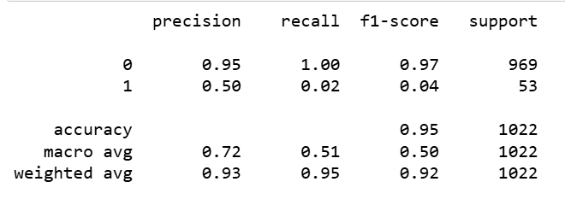
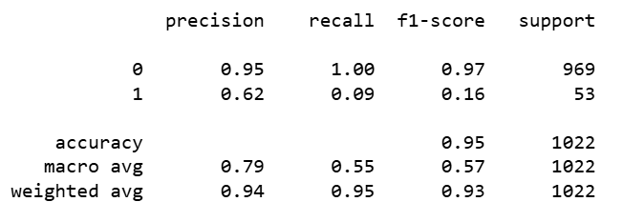
The Results
Logistic Regression
Random Forest Classifier
Notes:
For the logistic regression model, the results show the accuracy score is 94.81% with the accuracy score function. This model is close to average at predicting whether patients will not get a stroke with a f1-score of 97%. Since the random forest classifier model performed better, I will go into further detail for that one. These results show the accuracy score is 95.01% with the accuracy score function. For the random forest classifier model, the precision for the non-stroke patient is 0.95, recall is 1.0, and the f1-score is 0.97. For the stroke outcome, precision score is 0.62, recall is 0.09, and f1-score is 0.16. This indicates that out of all the stroke patients, the model predicted, 62% had one. Out of all the patients that did get a stroke, the model predicted this outcome correctly for 9% of those patients. This model is also better at predicting non-stroke patients like the logistic regression model with precision of 95%. Out of all the non-stroke patients, the model predicted their outcome correctly very accurately. The f1-score, mean of precision and recall, is also better for non-stroke patients, 97%, compared to the stroke patients of 16%.

Slide 7
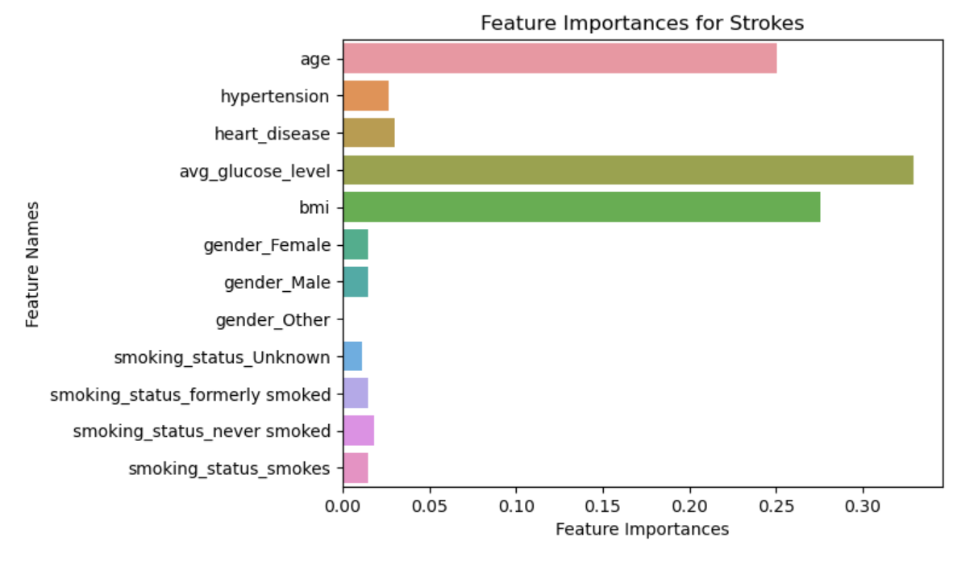
Important Features
Top feature: Average glucose levels
Second: Body Mass Index
Third: Age
Notes:
After looking at a correlation matrix and creating a bar graph with the top features that affect a stroke or non-stroke outcome, there were 3 that stood out substantially. The top 3 features were average glucose levels, BMI, and age.

Slide 8
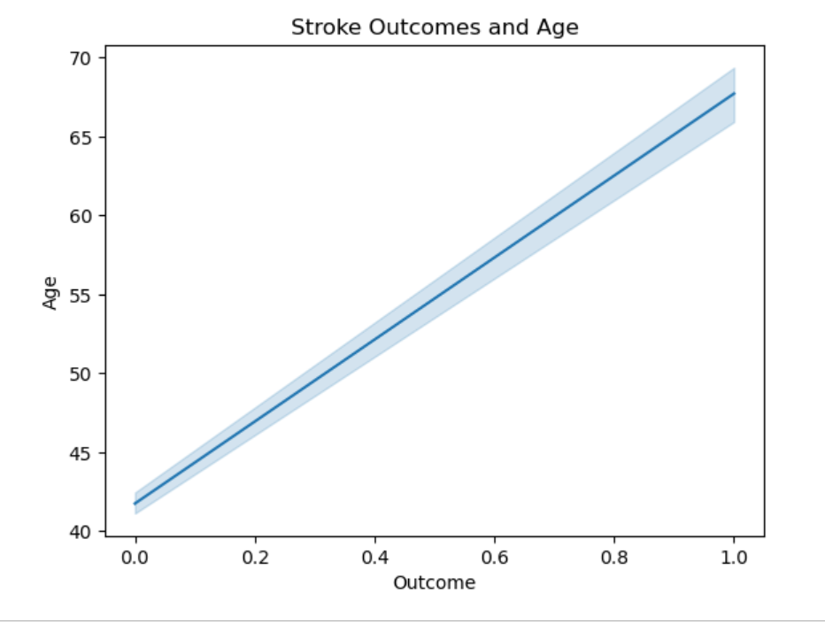
Visual on strokes and age
The line graph shows the correlation between age and a stroke outcome. The 40-year-old patients were at the non-stroke outcome vs the older a patient got, the more likely they got a stroke. This provides insight on strokes not only happening to the elderly over 65-years-old

Slide 9
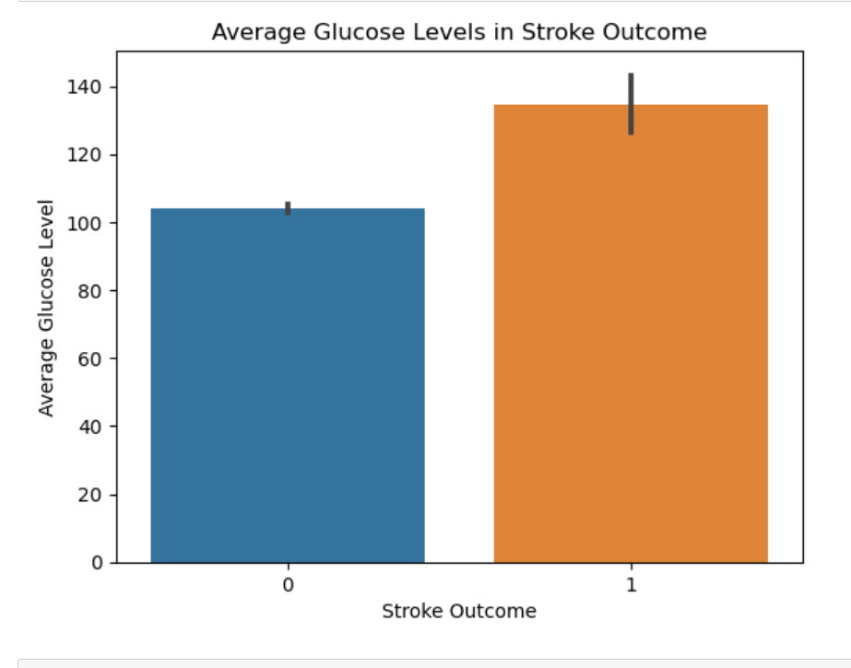
Visual on strokes and average glucose levels
Bar chart comparing the average glucose levels for the stroke and non-stroke outcomes.
Non-stroke (outcome 0) average glucose levels were a little over 100.
The average glucose levels for stroke (outcome 1) were greater, closer to 140.
Notes:
This helps as one can look at their own glucose levels and compare to the average levels for strokes from the dataset.

Slide 10
Conclusion
The models
The visualizations
Recommendations
Notes:
In my case, the logistic regression and random forest classifier were close in results, but the random forest classifier performed better. Insights found from my analysis are glucose levels and what the averages were for the stroke and non-stroke outcomes. The analysis also showed that strokes can occur in ages under 65, with strokes becoming more likely the older a person gets. The models can predict a non-stroke outcome with above average accuracy. Factors that I thought were going to be impactful with a stroke outcome such as smoking, hypertension, and heart disease were not as impactful in this analysis. Gender had little to no impact either. Recommendations are to use this model to spread awareness for the risks of stroke and how one can help prevent one from early on. “80% of strokes are preventable”, according to the Stroke Awareness Foundation

Slide 11
Sources
(2019, September 13). Why are strokes on the rise in younger people? Cleveland Clinic.
Why Are Strokes on the Rise in Younger People? (clevelandclinic.org)
(2020). Stroke prediction dataset. Kaggle. Stroke Prediction Dataset (kaggle.com)
(2024, May 15). Stroke facts. CDC. Stroke Facts | Stroke | CDC
About stroke. American Stroke Association. About Stroke | American Stroke Association
Stroke facts & statistics. Stroke Awareness Foundation. Stroke Facts & Statistics (strokeinfo.org)
Body mass index (BMI). World Health Organization (WHO). Body mass index (BMI) (who.int)

